Slide 1


Amateur Extra Licensing Class
Test Gear, Testing, Testing 1, 2, 3
Presented by
W5YI
Arlington, Texas

Slide 2
Amateur Radio Extra Class
Element 4 Course Presentation
ELEMENT 4 Groupings
  Rules & Regs
  Skywaves & Contesting
  Outer Space Comms
  Visuals & Video Modes
  Digital Excitement with Computers & Radios
  Modulate Your Transmitters
  Amps & Power Supplies
  Receivers with Great Filters

Slide 3
Amateur Radio Extra Class
Element 4 Course Presentation
ELEMENT 4 Groupings
  Oscillate & Synthesize This!
  Circuits & Resonance for All!
  Components in Your New Rig
  Logically Speaking of Counters
  Optops & OpAmps Plus Solar
  Test Gear, Testing, Testing 1,2,3
  Antennas
  Feedlines & Safety

Slide 4
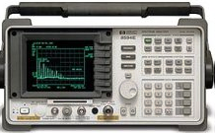
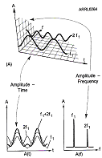
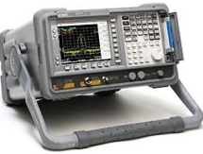
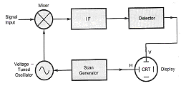
Amateur Radio Extra Class
Test Gear, Testing, Testing 1, 2, 3
E4A01… A spectrum analyzer differs from a conventional oscilloscope in that a spectrum analyzer displays signals in the frequency domain; an oscilloscope displays signals in the time domain.
E4A02… A typical spectrum analyzer display would display Frequency on the horizontal axis.

Slide 5
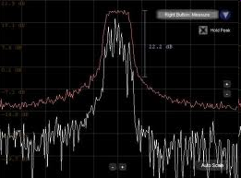
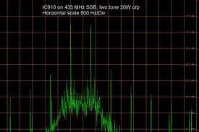
Amateur Radio Extra Class
Test Gear, Testing, Testing 1, 2, 3
E4A03… A typical spectrum analyzer displays signal Amplitude on the vertical axis.
E4A04… A spectrum analyzer can be used to display spurious signals from a radio transmitter.
E4A05… A spectrum analyzer can be used to display intermodulation distortion products in an SSB transmission.
E4A06… A spectrum analyzer could be used to determine the degree of isolation between the input and output ports of a 2 meter duplexer, whether a crystal is operating on its fundamental or overtone frequency, and the spectral output of a transmitter.

Slide 6
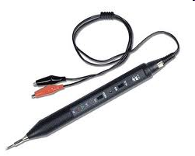
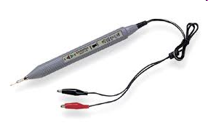
Amateur Radio Extra Class
Test Gear, Testing, Testing 1, 2, 3
E4A11…A logic probe can be used to indicate pulse conditions in a digital logic circuit.
E4A12…An important precaution to follow when connecting a spectrum analyzer to a transmitter output is to attenuate the transmitter output going to the spectrum analyzer
So that the Spectrum analyzer input is around 10 mW or less.

Slide 7
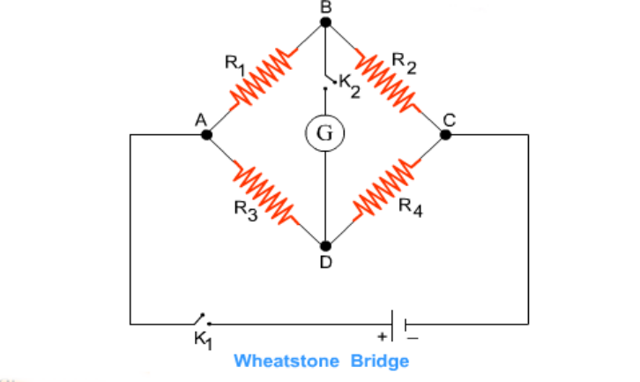
Amateur Radio Extra Class
Test Gear, Testing, Testing 1, 2, 3
E4B03… The advantage of using a bridge circuit to measure impedance is that the measurement is based on obtaining a null in voltage, which can be done very precisely.
E4B02… Time base accuracy has the most affect on the accuracy of a frequency counter.
If the ratio between R3 and R4 is the same as the ratio between R1 and R2 the bridge is balanced and the potential (voltage across points B and D will be) 0 volts. Bridges can be built for AC and RF as well as for DC.

Slide 8
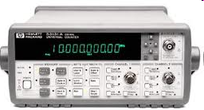
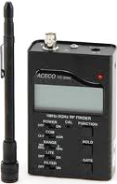

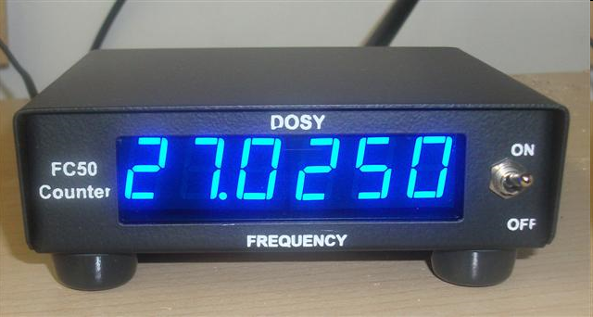
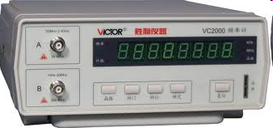
Amateur Radio Extra Class
Test Gear, Testing, Testing 1, 2, 3
E4B06… If a frequency counter with a specified accuracy of +/- 10 ppm reads 146,520,000 Hz, the most the actual frequency being measured could differ from the reading is 1465.20 Hz.
10 ppm is 10 per MHz
146.52MHz the uncertainty would be:
10Hz x 146.52
1465.20 Hz
Observe different number of significant digits in displays…watch the decimal point

Slide 9
Amateur Radio Extra Class
Test Gear, Testing, Testing 1, 2, 3
E4B04… If a frequency counter has a specified accuracy of +/- 1.0 ppm reads 146,520,000 Hz (146.52 MHz), the most the actual frequency being measured could differ from the reading is 146.52 Hz.
E4B05… If a frequency counter with a specified accuracy of +/- 0.1 ppm reads 146,520,000 Hz, the most the actual frequency being measured could differ from the reading is 14.652 Hz.
E4B01… Frequency stability is a characteristic of a good harmonic frequency marker.
E4B07… 75 watts of power is being absorbed by the load when a directional power meter connected between a transmitter and a terminating load reads 100 watts forward power and 25 watts reflected power.
1 ppm is 1 Hz per MHz
146.52 MHz the uncertainty would be:
1Hz x 146.52
146.52Hz
0.1 ppm is 0.1 Hz per MHz
146.52 MHz the uncertainty would be:
0.1Hz x 146.52
14.652Hz
Power Output – Power Reflected = Delivered Power
100 Watts – 25 Watts
75 Watts

Slide 10
Amateur Radio Extra Class
Test Gear, Testing, Testing 1, 2, 3
E4B08… It is good practice when using an oscilloscope probe to keep the ground connection of the probe as short as possible.
E4B09…High impedance input is a characteristic of a good DC voltmeter.
E4B10… If the current reading on an RF ammeter placed in series with the antenna feedline of a transmitter increases as the transmitter is tuned to resonance there will be more power going into the antenna.
The reason for this is that at RF frequencies the ground connection lead will look like an inductor and cause measurement inaccuracies.
The higher the input impedance of the voltmeter, the less of a load it will place on the circuit being measured. Most of today’s digital voltmeters have fixed 10 megohm input impedance.

Slide 11
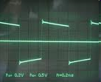
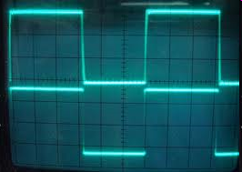
Amateur Radio Extra Class
Test Gear, Testing, Testing 1, 2, 3
E4B13… Voltmeter sensitivity, expressed in ohms per volt, can be used to determine the input impedance of the voltmeter by taking the full scale reading of the voltmeter multiplied by its ohms per volt rating. This will provide the input impedance (circuit loading resistance) of the voltmeter.
E4B14… The compensation of an oscilloscope probe is typically adjusted using a square wave that is observed and the probe is adjusted until the horizontal portions of the displayed wave is as nearly flat as possible.
For Example:
A 100 volt full scale voltmeter with an input sensitivity of 20,000 ohms per volt would be:
100 x 20,000;
2,000,000 ohms;
2 megohms
Not very flat horizontal lines
Nice flat horizontal lines

Slide 12
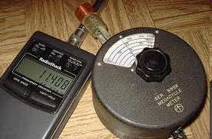
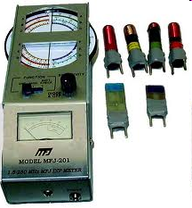
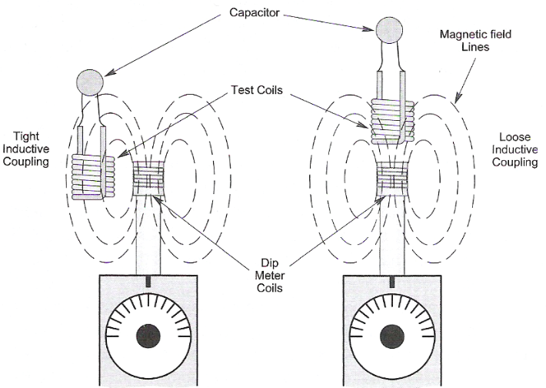
Amateur Radio Extra Class
Test Gear, Testing, Testing 1, 2, 3
E4B15… A less accurate reading will result if a dip-meter is too tightly coupled to a tuned circuit being checked.
Dip-meter under test conditions
Dip-meter and coils
Tight coupling Loose Coupling

Slide 13
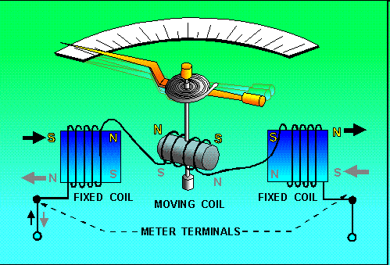
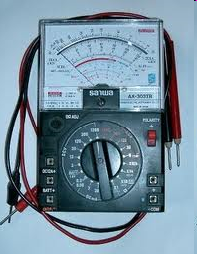
Amateur Radio Extra Class
Test Gear, Testing, Testing 1, 2, 3
E4B16… The Coil impedance of a D'Arsonval-type meter limits its accuracy.
D’Arsonval meter movement
VOM uses D’Arsonval movement

Slide 14
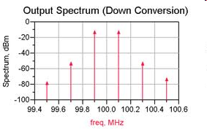
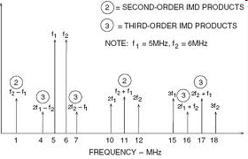
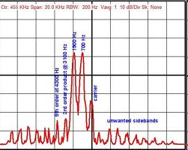
Amateur Radio Extra Class
Test Gear, Testing, Testing 1, 2, 3
E4B11…A method used to measure intermodulation distortion in an SSB transmitter is to modulate the transmitter with two non-harmonically related audio frequencies (in the audio pass band of the transmitter) while observing the RF output on a spectrum analyzer.
Intermodulation products shown at the output with a two-tone input
Second and third order inter-modulation products
Two main test tones of equal amplitude

Slide 15

Element 4 Extra Class
Question Pool
Test Gear, Testing,
Testing 1, 2, 3
Valid July 1, 2008
Through
June 30, 2012

Slide 16
E4A01 How does a spectrum analyzer differ from a conventional oscilloscope?
A spectrum analyzer measures ionospheric reflection; an oscilloscope displays electrical signals
A spectrum analyzer displays the peak amplitude of signals; an oscilloscope displays the average amplitude of signals
A spectrum analyzer displays signals in the frequency domain; an oscilloscope displays signals in the time domain
A spectrum analyzer displays radio frequencies; an oscilloscope displays audio frequencies

Slide 17
E4A02 Which of the following parameters would a typical spectrum analyzer display on the horizontal axis?
SWR
Q
Time
Frequency

Slide 18
E4A03 Which of the following parameters would a typical spectrum analyzer display on the vertical axis?
Amplitude
Duration
SWR
Q

Slide 19
E4A04 Which of the following test instruments is used to display spurious signals from a radio transmitter?
A spectrum analyzer
A wattmeter
A logic analyzer
A time-domain reflectometer

Slide 20
E4A05 Which of the following test instruments is used to display intermodulation distortion products in an SSB transmission?
A wattmeter
A spectrum analyzer
A logic analyzer
A time-domain reflectometer

Slide 21
E4A06 Which of the following could be determined with a spectrum analyzer?
The degree of isolation between the input and output ports of a 2 meter duplexer
Whether a crystal is operating on its fundamental or overtone frequency
The spectral output of a transmitter
All of these choices are correct

Slide 22
E4A11 Which of the following test instruments can be used to indicate pulse conditions in a digital logic circuit?
A logic probe
An ohmmeter
An electroscope
A Wheatstone bridge

Slide 23
E4A12 Which of the following procedures is an important precaution to follow when connecting a spectrum analyzer to a transmitter output?
Use high quality double shielded coaxial cables to reduce signal losses
Attenuate the transmitter output going to the spectrum analyzer
Match the antenna to the load
All of these choices are correct

Slide 24
E4B03 What is an advantage of using a bridge circuit to measure impedance?
It provides an excellent match under all conditions
It is relatively immune to drift in the signal generator source
The measurement is based on obtaining a null in voltage, which can be done very precisely
It can display results directly in Smith chart format

Slide 25
E4B02 Which of the following factors most affects the accuracy of a frequency counter?
Input attenuator accuracy
Time base accuracy
Decade divider accuracy
Temperature coefficient of the logic

Slide 26
E4B06 If a frequency counter with a specified accuracy of +/- 10 ppm reads 146,520,000 Hz, what is the most the actual frequency being measured could differ from the reading?
146.52 Hz
10 Hz
146.52 kHz
1465.20 Hz

Slide 27
E4B04 If a frequency counter with a specified accuracy of +/- 1.0 ppm reads 146,520,000 Hz, what is the most the actual frequency being measured could differ from the reading?
165.2 Hz
14.652 kHz
146.52 Hz
1.4652 MHz

Slide 28
E4B05 If a frequency counter with a specified accuracy of +/- 0.1 ppm reads 146,520,000 Hz, what is the most the actual frequency being measured could differ from the reading?
14.652 Hz
0.1 MHz
1.4652 Hz
1.4652 kHz

Slide 29
E4B01 Which of the following is a characteristic of a good harmonic frequency marker?
Wide tuning range
Frequency stability
Linear output amplifier
All of the above

Slide 30
E4B07 How much power is being absorbed by the load when a directional power meter connected between a transmitter and a terminating load reads 100 watts forward power and 25 watts reflected power?
100 watts
125 watts
25 watts
75 watts

Slide 31
E4B08 Which of the following is good practice when using an oscilloscope probe?
Keep the ground connection of the probe as short as possible
Never use a high impedance probe to measure a low impedance circuit
Never use a DC-coupled probe to measure an AC circuit
All of these choices are correct

Slide 32
E4B09 Which of the following is a characteristic of a good DC voltmeter?
High reluctance input
Low reluctance input
High impedance input
Low impedance input

Slide 33
E4B10 What is indicated if the current reading on an RF ammeter placed in series with the antenna feedline of a transmitter increases as the transmitter is tuned to resonance?
There is possibly a short to ground in the feedline
The transmitter is not properly neutralized
There is an impedance mismatch between the antenna and feedline
There is more power going into the antenna

Slide 34
E4B13 What is the significance of voltmeter sensitivity expressed in ohms per volt?
The full scale reading of the voltmeter multiplied by its ohms per volt rating will provide the input impedance of the voltmeter
When used as a galvanometer, the reading in volts multiplied by the ohms/volt will determine the power drawn by the device under test
When used as an ohmmeter, the reading in ohms divided by the ohms/volt will determine the voltage applied to the circuit
When used as an ammeter, the full scale reading in amps divided by ohms/volt will determine the size of shunt needed

Slide 35
E4B14 How is the compensation of an oscilloscope probe typically adjusted?
A square wave is observed and the probe is adjusted until the horizontal portions of the displayed wave is as nearly flat as possible
A high frequency sine wave is observed, and the probe is adjusted for maximum amplitude
A frequency standard is observed, and the probe is adjusted until the deflection time is accurate
A DC voltage standard is observed, and the probe is adjusted until the displayed voltage is accurate

Slide 36
E4B15 What happens if a dip-meter is too tightly coupled to a tuned circuit being checked?
Harmonics are generated
A less accurate reading results
Cross modulation occurs
Intermodulation distortion occurs

Slide 37
E4B16 Which of these factors limits the accuracy of a D'Arsonval-type meter?
Its magnetic flux density
Coil impedance
Deflection rate
Electromagnet current

Slide 38
E4B11 Which of the following describes a method to measure intermodulation distortion in an SSB transmitter?
Modulate the transmitter with two non-harmonically related radio frequencies and observe the RF output with a spectrum analyzer
Modulate the transmitter with two non-harmonically related audio frequencies and observe the RF output with a spectrum analyzer
Modulate the transmitter with two harmonically related audio frequencies and observe the RF output with a peak reading wattmeter
Modulate the transmitter with two harmonically related audio frequencies and observe the RF output with a logic analyzer

